Slide 1
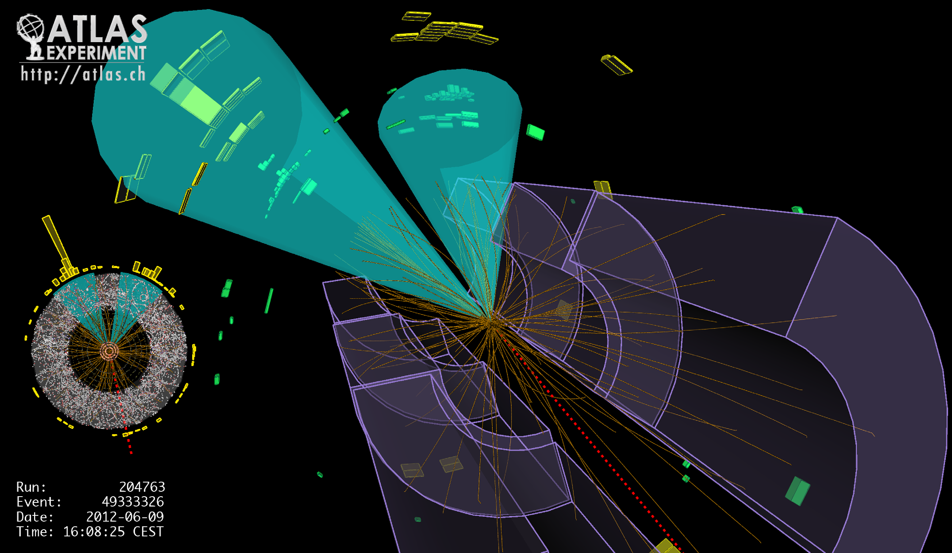
Lecture #7
Prof. Dr. Florencia Canelli
Universität Zürich
Elementary particle physics - PHY451
HS2016

Slide 2
November revolution
1974: observation of the J/Ψ particle rescues the quark model
C.C.Ting et al. at Brookhaven AGS proton synchrotron (names particle J)
B.Richter et al. at SLAC/Spear e⁺e⁻ collider with Mark-I detector (names particle Ψ)

Slide 3
A brief reminder

Slide 4
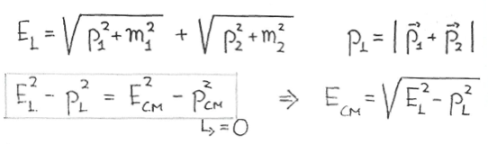
Inelastic particle collisions
For a collision in the laboratory frame between two particles: (m₁,p₁) and (m₂,p₂)
If we want to produce 3 protons and 1 antiproton colliding a proton beam against a proton target (pp→ppp(anti-p)), what is the minimum momentum of the proton beam?
Solution
m₁ = m₂ = 0.9383 Gev/c²
m(anti-proton) = m(proton)
p_{L}=p₁, p₂=0
At threshold: E_{CM} = 4m = 3.7532 GeV
Solving for p₁: p₁=6.5 GeV/c
Note that in general we won’t be writing c in equations

Slide 5
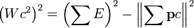
Invariant mass
Characteristic of the total energy and momentum of an object or a system of objects that is the same in all frames of reference
When the system as a whole is at rest, the invariant mass is equal to the total energy of the system (divided by c²⁾. If the system consists of one particle, the invariant mass may also be called the rest mass
For a system of N particles:
where W is the invariant mass of the decaying particle
In a two body decay M→1+2:
natural units (c=1):

Slide 6
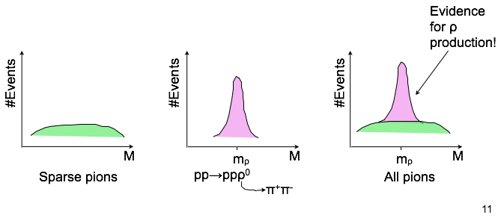
Invariant mass
Particles like ρ, ω, ϕ have average lifetime of 10⁻²²-10⁻²³ s
How do we know of their existence if they live so shortly?
Example: reaction pp→ppρ⁰→ppπ⁺π⁻
We identify all four particles in the final state and measure their momentum
Let’s focus on the pion pair, the total energy & momentum are:
The invariant mass is:
The event distribution for the variable M will look like:
E=E⁺+E⁻ p=p⁺+p⁻
M = (E² - p²)^{1/2}

Slide 7
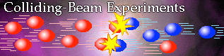
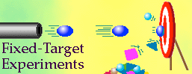
Particle accelerators
Accelerate beam of stable particles (e.g. protons, anti-protons, electrons, etc. )
Two options:
Collide with other beams and study resulting interactions
Collide against a fixed target and produce a secondary beam to study

Slide 8
Fixed target vs colliders
E_{CM} is the energy available to generate mass
In the CM frame p_{A} = - p_{B}
Fixed target
In lab frame p_{B}=0, E_{B}=m_{B}
If we want to produce 2 top quarks (m=173 GeV) at rest the energy of the beam necessary would be about 60 TeV

Slide 9
Fixed target vs colliders
E_{CM} is the energy available to generate mass
In the CM frame p_{A} = - p_{B}
Colliders
In lab frame p_{B}=-p_{A}, E_{B}=E_{A}
If we want to produce 2 top quarks (m=173 GeV) at rest the energy of the beam necessary would be about 173 GeV

Slide 10
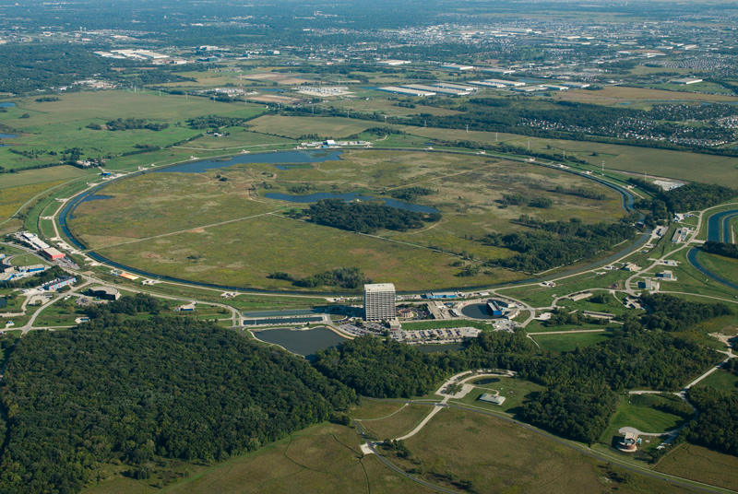
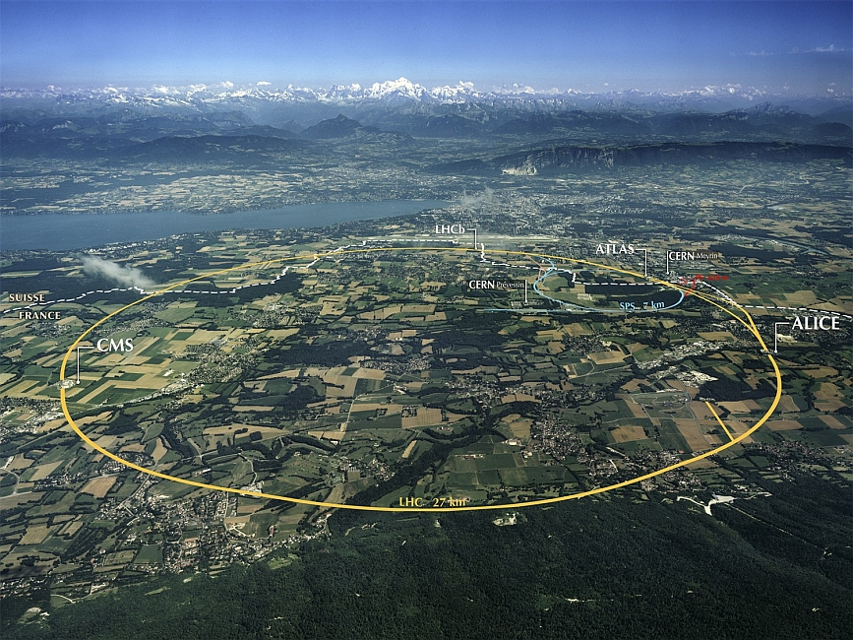
Colliders
In beam-beam collisions: E_{CM}=2 x E_{beam}
Problem:
Particle density in a beam is much lower than solid or liquid target
Solutions:
Cross beam many times
Maximize beam intensity (number of particle bunches per beam)
Constraints:
Works only with stable (anti)particles (protons,electrons)
High vacuum needed to avoid beam-gas interactions: ~10⁻⁹ Pa
particle-antiparticle → circulate in the same beam line, opposite directions (ex: Tevatron)
particle-particle → circulate in two separate beam lines (ex: LHC)

Slide 11
End of reminder

Slide 12
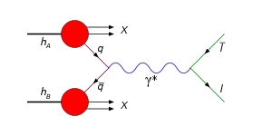
Back to 1974
Experiments were investigating the Drell-Yan process to understand the quark-parton model
And electron positron annihilation at higher energies
Drell-Yan: production of lepton pairs in hadronic collisions
e⁺
q
γ
e–
q

Slide 13
Predicting the charm quark
The first speculations about ”charm”
J.D. Bjorken and S.L. Glashow, Phys. Lett. 11 (1964) 255
Massive lepton-pair production in h-h collisions
S. D. Drell and T-M Yan, Phys. Rev. Lett. 25 (1970) 316
Weak interactions with lepton-hadron symmetry
S.L. Glashow, J. Iliopoulos and L. Maiani, Phys. Rev. D (1970) 1285
In April 1974 S.L. Glashow said ”There are just three possibilities:
1. Charm is not found and I eat my hat
2. Charm is found by hadron spectroscopy, and we celebrate
3. Charm is found by outlanders, and you eat your hats.”
International Conference on Experimental Meson Spectroscopy, 2-27 April 1974 Boston. Source: Fermilab-Conf97/432-E (story by John Yon for the E288 collaboration)s

Slide 14
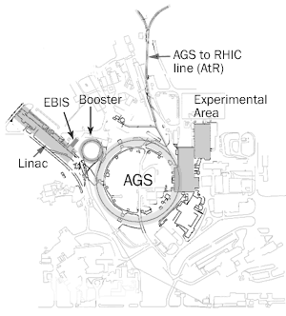
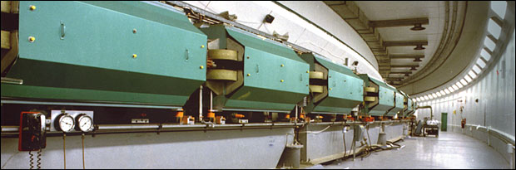
Alternating Gradient Syncrothron (AGS)
The AGS name is derived from the concept of alternating gradient focusing, in which the field gradients of the accelerator's 240 magnets are successively alternated inward and outward, permitting particles to be focused in both the horizontal and vertical plane at the same time. Capable of accelerating 70 trillion protons with every pulse, and heavy ions such as gold and iron, the AGS receives protons and other ions from the AGS Booster and delivers them to the Relativistic Heavy Ion Collider after acceleration.
BNL= Brookhaven National Laboratory

Slide 15
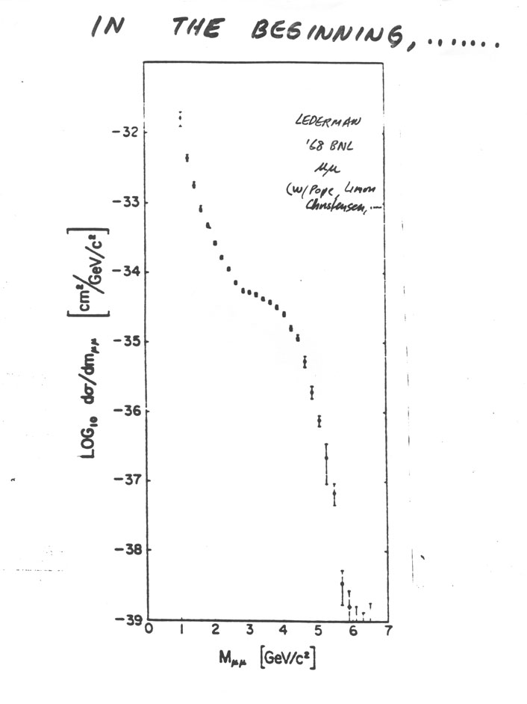
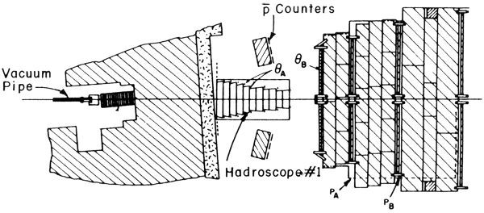
Dimuon measurements at AGS
From the fixed target experiment (Lederman et al. – see muon neutrino discovery)
steal
μ₁
Uranium target
θ₁₂
μ₂
Concrete
Dense Uranium target
Pion/Kaon absorbtion
Steal/Concrete Absorbers
p > 6 GeV/c, p_{T} > 450 MeV/c
Angle hodoscopes (hadroscope)
μ angle measurement
Momentum hodoscopes (P_{A}, P_{B})
Initial p_{μ} measurement

Slide 16
Dimuon measurements at AGS
From the fixed target experiment (Lederman et al. – see muon neutrino discovery)
Publication: Phys. Rev. D8 (1973) 2016
Concluded: Muon pairs with effective masses 1 GeV and 6.5 have been observed in the collisions of 30-GeV protons with a uranium target. The production cross section was seen to vary smoothly with mass exhibiting no resonant structure.
1nb
?
1pb
Experimental shortcomings:
dimuon tesolution ~25% at 3 GeV
p+U →μ⁺μ⁻+X
A year later S. Ting’s completed a new experiment using electron/positrons

Slide 17
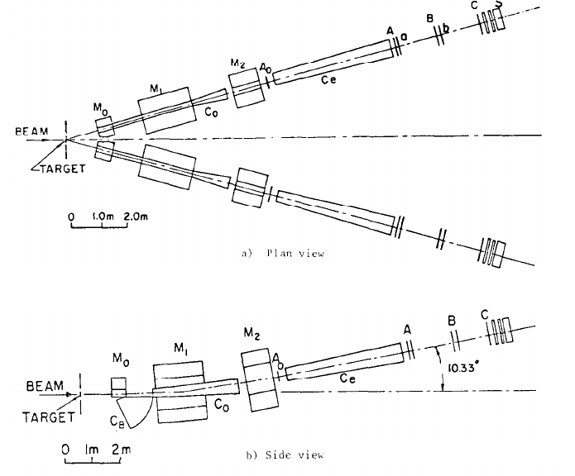
J resonance in AGS
Fixed target experiment at BNL: proton collisions on a Berilium target
e⁻
Goal: measure the leptonic widths of meson decays
Experimental setup:
Two arm spectrometer
Cherenkov counters to separate electrons from hadrons
e⁺
Measure
Resolution: ~20 MeV great improvement over muon result
(more at tomorrow’s presentation)

Slide 18
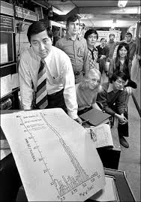
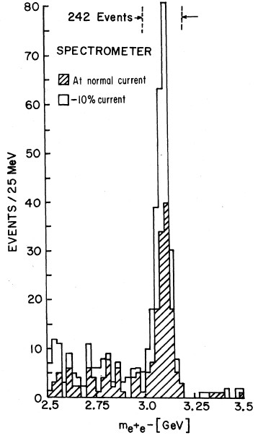
J resonance in AGS
S. Ting
Resonance found in the invariant mass spectrum

Slide 19
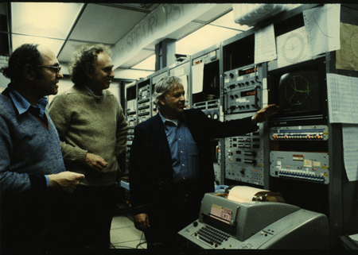
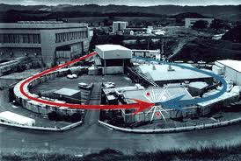
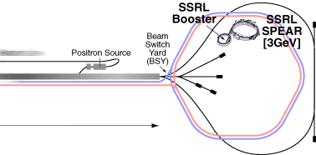
ψ resonance in SPEAR
SPEAR (Stanford Positron Electron Accelerating Ring) machine at SLAC, completed in 1972. SPEAR consists of a single ring some 80 meters in diameter, in which counter-rotating beams of electrons and positrons were circulated at energies up to 4 GeV
G. Goldhaber, M. Perl, B. Richter
The SPEAR parameters:
15-30 min. filling time
2 h data taking
2.6-8.0 GeV c.m. e+e⁻ energy
SLAC Linac
e⁻
e⁺

Slide 20
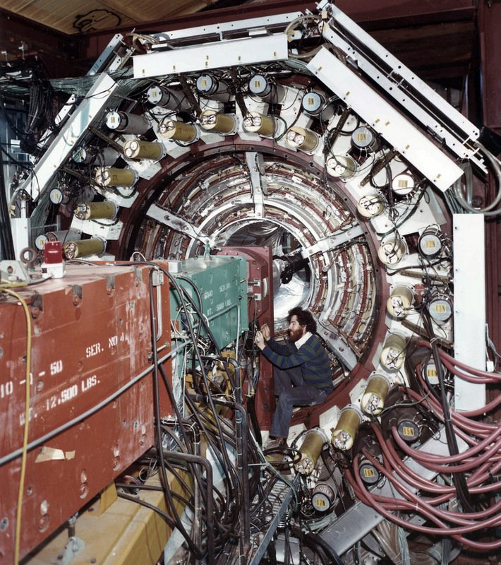
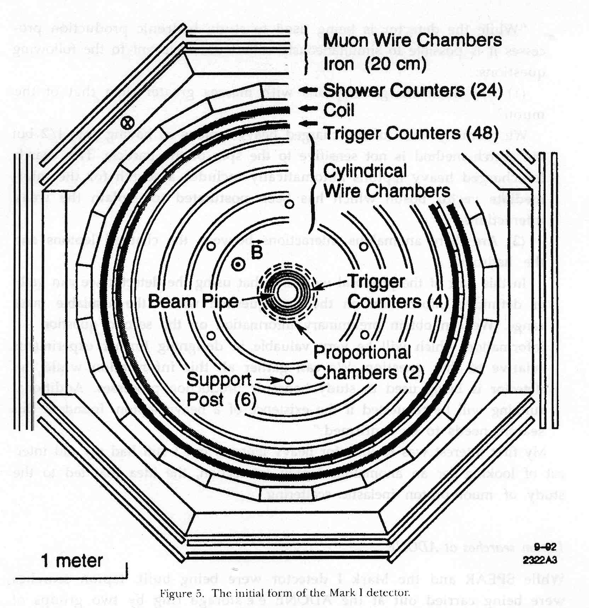
ψ resonance in SPEAR/Mark I
Mark I detector: spark chambers (16) inside a solenoidal magnet of 4.6 kG surrounded by time of flight (tof) counters for particle velocity measurements, shower counters for photon detection and electron identification and by proportional counters embedded in iron absorbers slabs for muon identification
A general purpose detector

Slide 21
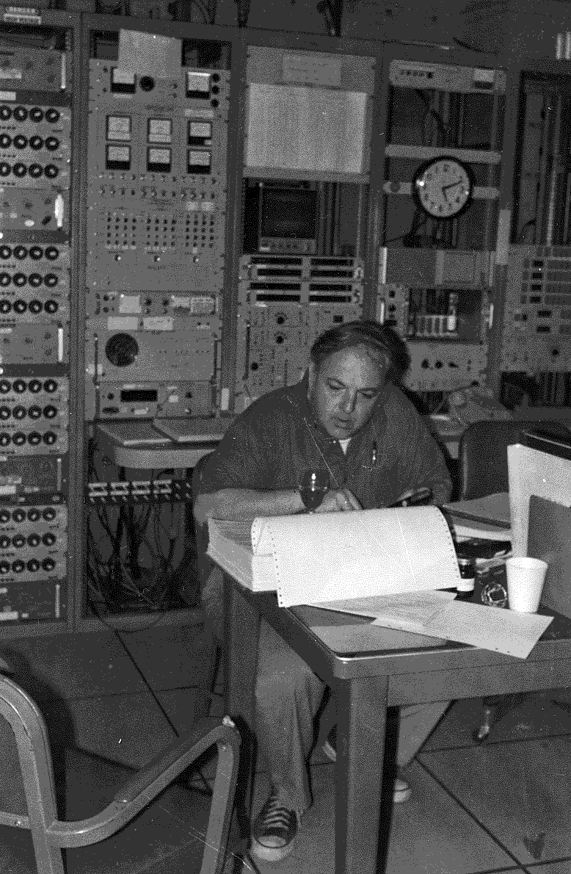
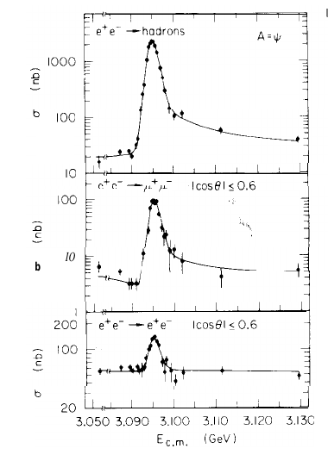
ψ resonance in SPEAR/Mark I
Width
BW cross section
+beam spread (Gauss)
+radiative effects
Γ_{h}
B. Richter
Γ_{μ}
Huge counting rate in narrow range of E_{beam}
Spread of beam comes from synchrotron radiation of the beams
Apparent width of peak = 1.3 MeV, consistent with E_{cm} resolution
Produced in e+e- annihilation; resonance presumed to have same quantum numbers as the photon
J^{PC} = 1⁻⁻
Γ_{e}

Slide 22
J/ψ discovery
Properties of the J/ψ
produced as a narrow resonance
not consistent with standard strong decay
must be conserved quantum number that suppresses strong decay
decays into leptons (electromagnetically!) with significant probability
mass is larger than the proton mass !!! (1.5 GeV )
Quickly interpreted as a bound state of two new quarks → “charm quark” → charmonium

Slide 23
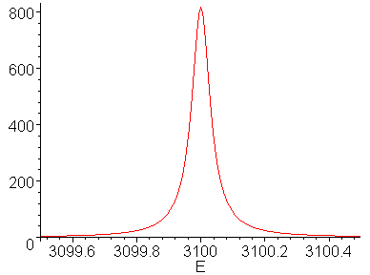
Determining the J/ψ width
Observed width of the peaks are dominated by experimental resolution
Determine the true decay length will tell us what type of interaction of the decay
Observed peak
True peak
ΔE_{beam}
3
E
3.15

Slide 24
Determining the J/ψ width – Breit-Wigner decays
True width, Breit-Wigner
E, CMS energy, determine by the experiment
E_{R} resonance peak energy, observed in result
Γ total width, Γ _{e+e-} partial width to e⁺e⁻: ratio measurement 0.06
s₁=s₂= ½ and assume J=1

Slide 25
Determining the J/ψ width – Breit-Wigner decays
Total cross section measured is 800 nb
We can extract the total decay length
Compare with other mesons formed from light quarks (u, d, s)
ρ(776 MeV) Γ= 150 MeV, ω(784 MeV) Γ = 8.4 MeV
J/Ψ width is extremely small !
Mark I results 0.068 MeV

Slide 26
What makes charmonium special ?
Charm quark mass 1:5 GeV
Charmonium bound state almost non-relativistic: β~0.4
Can treat using non-relativistic QM (with perturbative relativistic corrections)
In fact the discovery of J/Ψ had a remarkable resemblance with the positronium

Slide 27
Resemblance with Positronium
Bound states of quarks can be regarded as hydrogen energy levels in the electron/proton system (positronium)
The energy spacing between these levels are very large and we regard them as different particles

Slide 28
Positronium
Bound state of electron and positron, non-relativistic
2 particles orbiting about a common center
Solve hydrogen atom (Schroedinger equation) but with reduced mass m_{red} = m/2, using Coulombs potential V(r) = - e²/r
Wave functions are the same as Hydrogen’s with Bohr radius a^{pos} = 2a=1.06 10⁻⁸ cm (doubled)
e⁺
e⁻
First bound state -6.8 GeV

Slide 29
Quarkonium
Can we apply the positronium case to mesons ?
Yes, if non-relativistic:
heavy mesons (bb, cc, bc)
if the binding energy is small compared with the rest energies of the systems (quark-quark binding energies are a few hundred MeV)
Forces are not EM, quarks are bound by the strong force. An educated guess of the potential could be
Increases without limit at high distances, confinement
Coulomb at short range
α_{S} strong coupling constant
Use this potential for the quarks and fit the data to α_{S} and F₀.
Discover: α_{S} = 0.3 and F₀ is 16 tons! (no free quarks)

Slide 30
J/ψ quantum numbers
J/ψ produced in e⁺e⁻ from a virtual photon
J^{PC} = 1⁻⁻ (odd parity and charge conjugation)
Use same quantum numbers as for positronium
^{2S+1}L_{J}
First combine spin of the q and q, then combine with orbital angular momentum to get J
We will see that
J/ψ = ³S₁
Quark spin=1, orbital angular momentum=0, total J/ψ spin=1

Slide 31
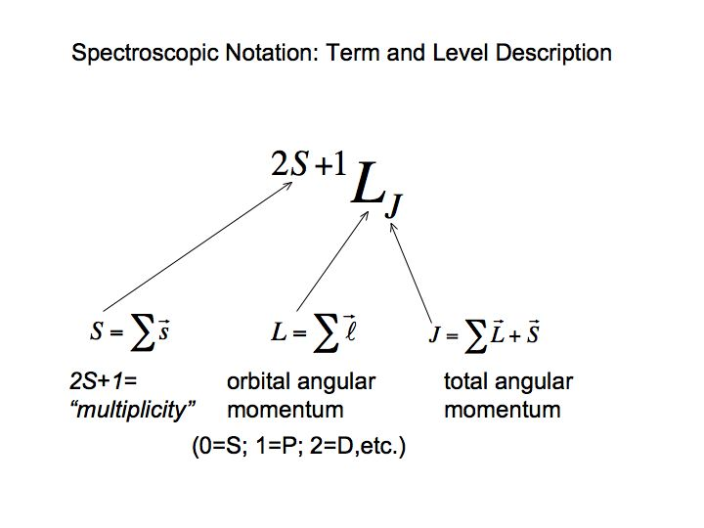
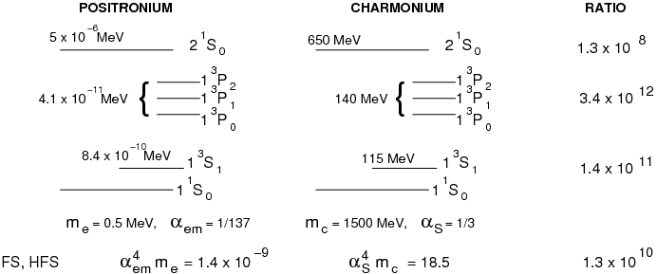
Charmonium levels
Similar spectrum between positronium and charmonium
Gap between n=1 levels (hyperfine structure for hydrogen) is greater by a factor of 10¹¹ in charmonium

Slide 32
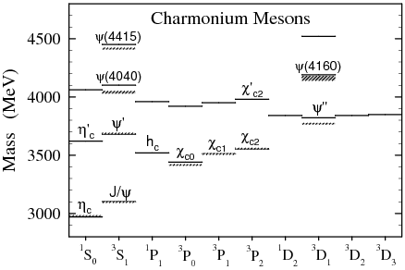
Charmonium mesons
J/Ψ was identified as the 1³S₁ state of the charmonium
Predicted Ψ’ at 3.7 GeV, found weeks later, same quantum numbers, produced just by cranking up beam energy

Slide 33
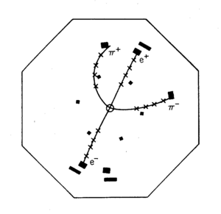
Discovery of the J/Ψ’ in e⁺e⁻ annihilation
Another narrow resonance with the same quantum numbers as the photon (10 days after Ψ)
Mass of Ψ’ = 3686 MeV
The Ψ’ is also called the Ψ(2S)
Observed decays include:
To other cc states
Ψππ (50%), χ_{C}+γ (24%)
Dileptons (1% per lepton species)
Additional hadronic decays make up the rest
Event of Ψ’ excited state at m=3.7 GeV

Slide 34
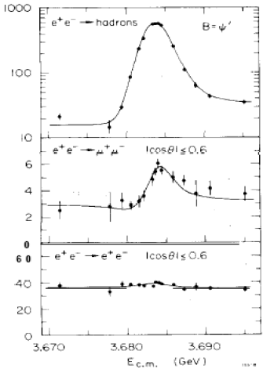
Discovery of the J/Ψ’ in e⁺e⁻ annihilation
Another narrow resonance with the same quantum numbers as the photon (10 days after Ψ)
Mass of Ψ’ = 3686 MeV
The Ψ’ is also called the Ψ(2S)
Observed decays include:
To other cc states
Ψππ (50%), χ_{C}+γ (24%)
Dileptons (1% per lepton species)
Additional hadronic decays make up the rest
Event of Ψ’ excited stat at m=3.7 GeV

Slide 35
Charm quarks
Interpretation of J/Ψ as cc bound state supported by behavior of R
Two narrow states below charmed meson threshold
Wider states can decay to charmed particles
Jump in R above threshold indicates charge 2/3 quark

Slide 36
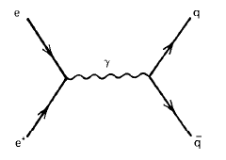
e⁺e⁻ annihilation to hadrons
The process
Its cross section
We take in account the fractional charge of the quark, e_{q}
N_{c} is the number of colors, 3
There is a diagram for each color, and they have to be added

Slide 37
e⁺e⁻ annihilation to hadrons
This leads us to the prediction
Since N_{C}=3 we have
for u,d,s
for u,d,s,c
for u,d,s,c,b
Above 3.1 GeV, charm pairs produced
Above 9.4 GeV, bottom pairs produced

Slide 38
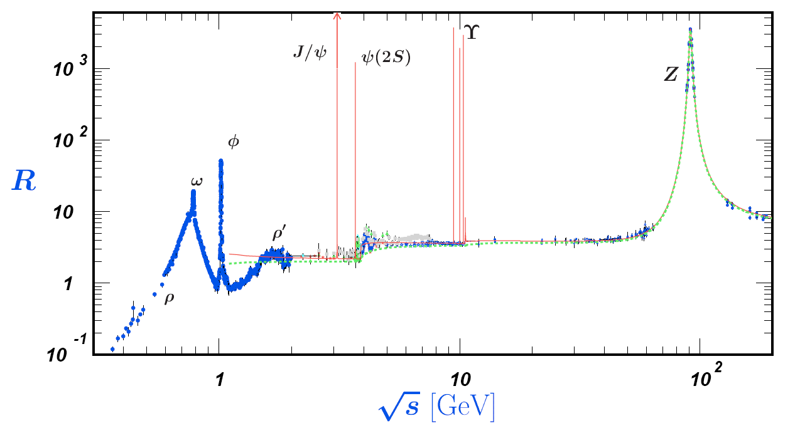
e⁺e⁻ annihilation to hadrons

Slide 39
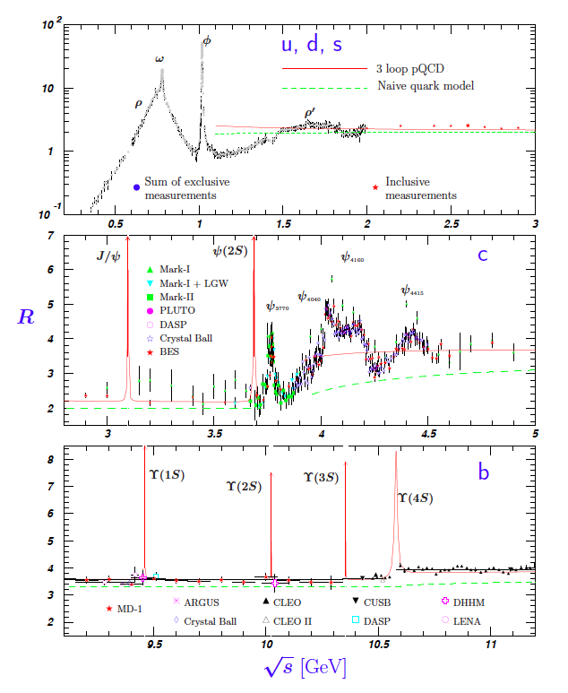
e⁺e⁻ annihilation to hadrons
Jump in R above threshold indicates charge 2/3 quark
These measurements confirm that there are 3 colors of quarks
R is modified when interpreted with QCD. It should include diagrams where one of the quarks radiate gluons
Will return to this in a couple of lectures

Slide 40
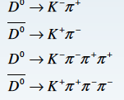
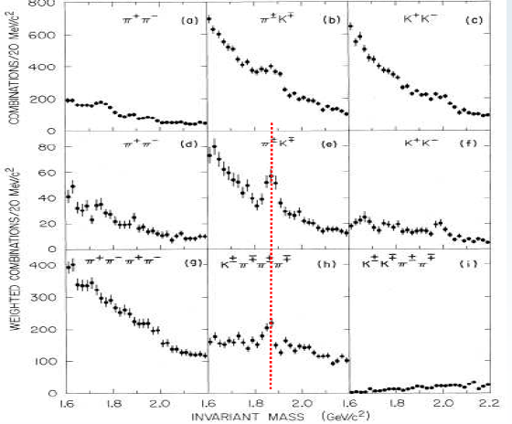
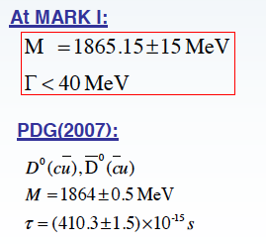
Discovery of charmed neutral mesons at SPEAR
at E_{cm} = 3.9, 4.6 GeV
(more at tomorrow’s presentation)

Slide 41
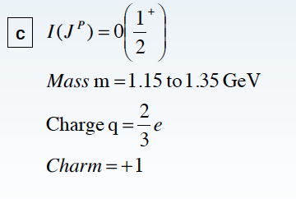
Charm quark

Slide 42
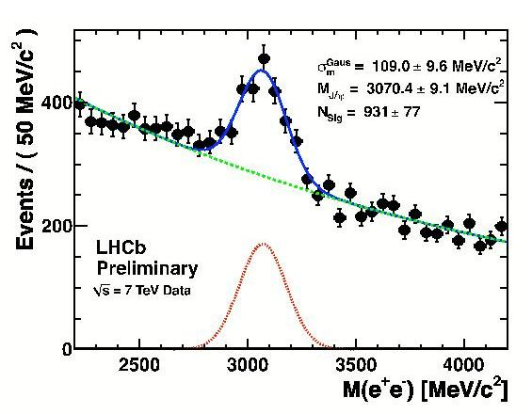
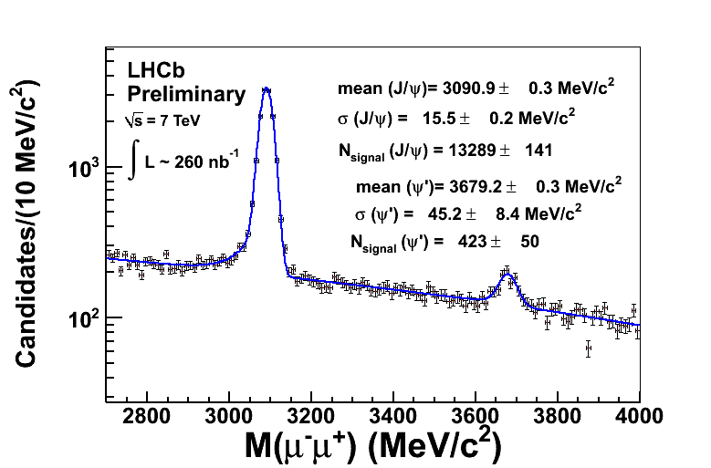
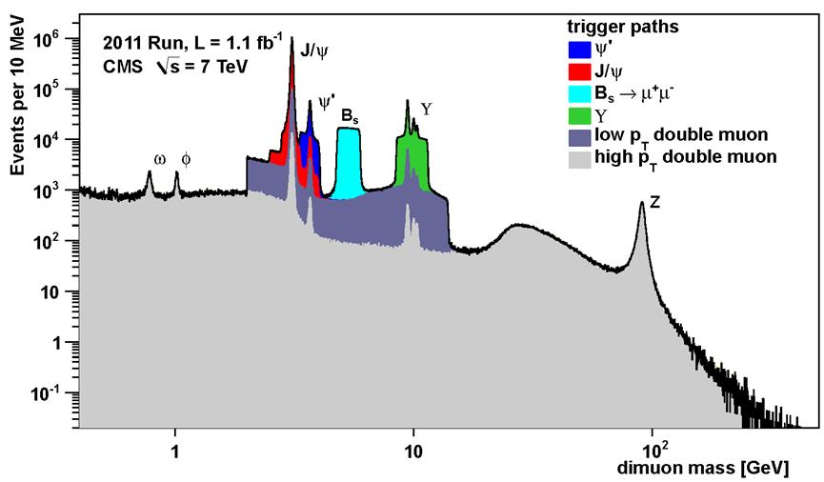
Charmonium - today
Still topic of study, cross section and polarization
Also used as a calibration peak

Slide 43
The quark model (so far)
Leptons: e, ν_{e}, μ, ν_{μ}
Quarks: d,u,s, c
The idea of a fourth flavor was already introduced by keeping parallel to lepton sector
Made the quark model more compelling
It predicted more mesons and baryons, first one discovered in 1976 D⁰ and D⁺
However in 1975 the tau lepton is discovered…
More in tomorrow’s presentation

Slide 44
Tuesday lectures
Date | Topic | Student
Sept 27 | Positron (p9) Muon (p29) Pion (p34) | Nici Alex Kevin
Oct 4 | Unstable particles (p65 or p71) Anti-p (p87) or Anti-n (p94) | Lukas Oliver
Oct 11 | Omega-(p144) Parity violation in beta (p163) Parity violation in pions (165) | Magnus Nici Alex
Oct 18 | K-long (p197) CP violation (p206) | Kevin Lukas
Oct 25 | Tau lepton J and Psi Charm meson | Oliver Magnus Nici
Nov 2 | Quarks SLAC Gluons TASSO Upsilon | Magnus Kevin Lukas
Date | Topic | Student
Nov 8 | Jets UA2 CLEO b | Alex
Nov 15 | Neutral currents Discovery of the W boson Neutrino species
Nov 22 | Discovery of the top quark Top quark mass measurement
Nov 29 | ARGUS CDF (or Belle/Babar)
Dec 6 | Solar Atmospheric
Dec 20 | Higgs discovery by ATLAS or CMS Measurements of Higgs boson properties
From pages from R. Cahn and G. Goldhaber book if available

